Slide 1





Sprout Haven
by Eleuterio, Ezekiel

Slide 2
Systems Architecture
  User Browser - runs HTML/CSS frontend for layout and styling.
  Web Server - executes PHP backend logic, handles requests, and communicates with the database.
  Database Server - stores data in MySQL (products, users, orders).

Slide 3
Systems Architecture
Pages needed:
  Home
  Products
  About
  Contact
  Account
  Checkout/Cart

Slide 4
Database Design
erDiagram
USERS ||--o{ ORDERS : places
USERS ||--o{ FORMS : submits
USERS {
int user_id PK
string username
string email
string password_hash
datetime created_at
}
PRODUCTS {
int product_id PK
string name
string description
float price
int stock_quantity
}
ORDERS {
int order_id PK
int user_id FK
string products_json
float total_amount
string status
datetime created_at
}
FORMS {
int form_id PK
int user_id FK
string questions_json
string answers_json
datetime submitted_at
}

Slide 5
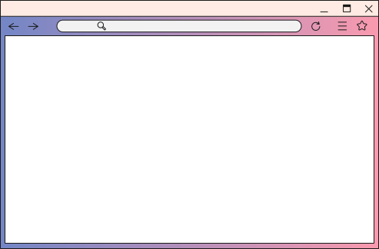


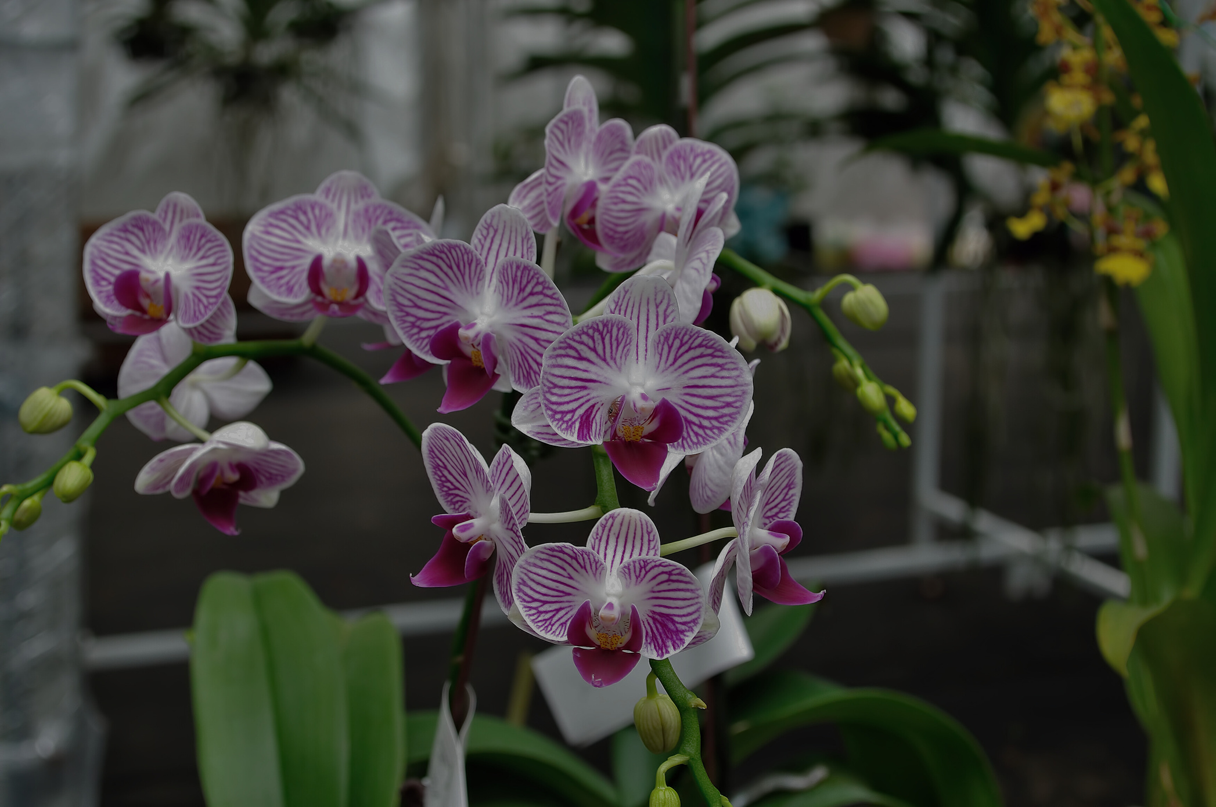

Home
Products
About Us
Contact Us
Add another plant to your collection!

Slide 6

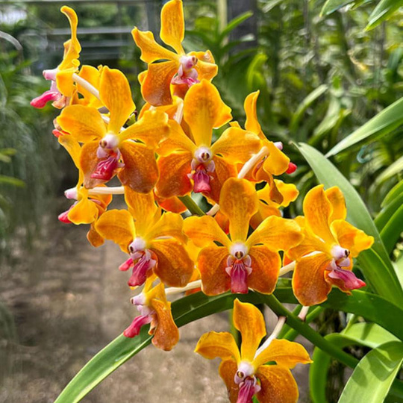
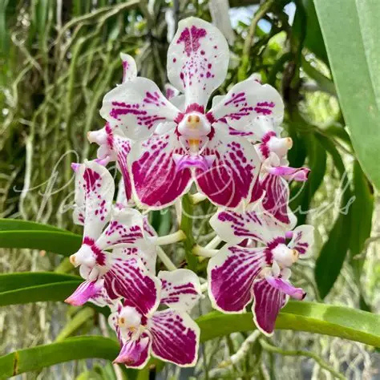
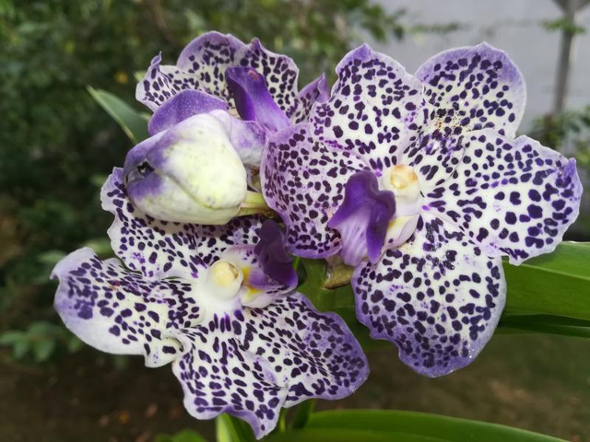

Add another plant to your collection!
Shop Now
Shop Best Sellers
Vanda MV Tannins
Vanda Saidah Nafisah
Vanda Omar Padron
Rosa ‘Koko Loko’

Slide 7


Rosa ‘Fragrant Cloud’
(23)
₱ 850
Shipping Calculated at Checkout.
Quantity:
1
Description
Product Details

Slide 8
Got Questions? Contact Us!
Name:
Email:
Question:
Address: 2099 Brevard Rd., Arden, NC 28704
Tel No.: 855-440-2929
Email: service@sprouthaven.com

Slide 9
Thank You

